Slide 1
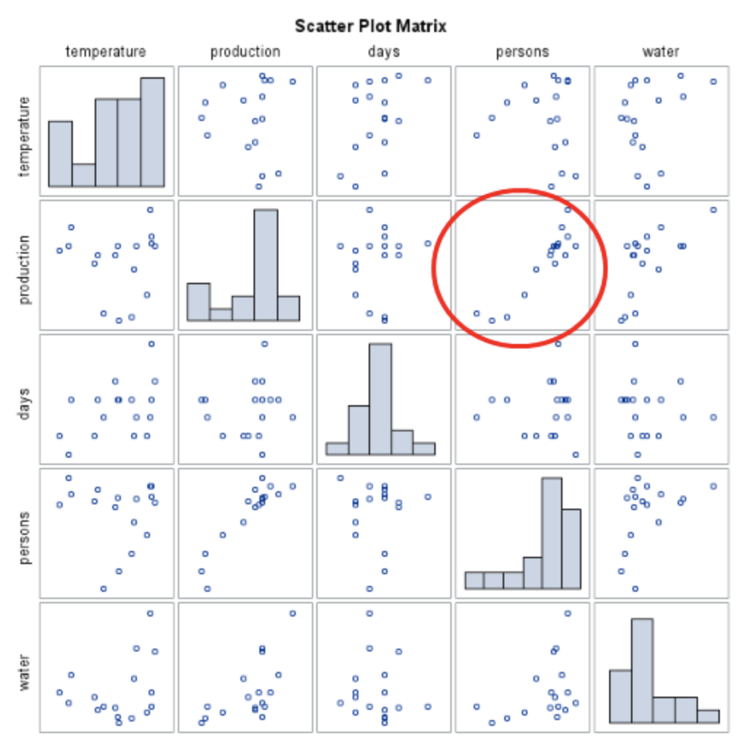
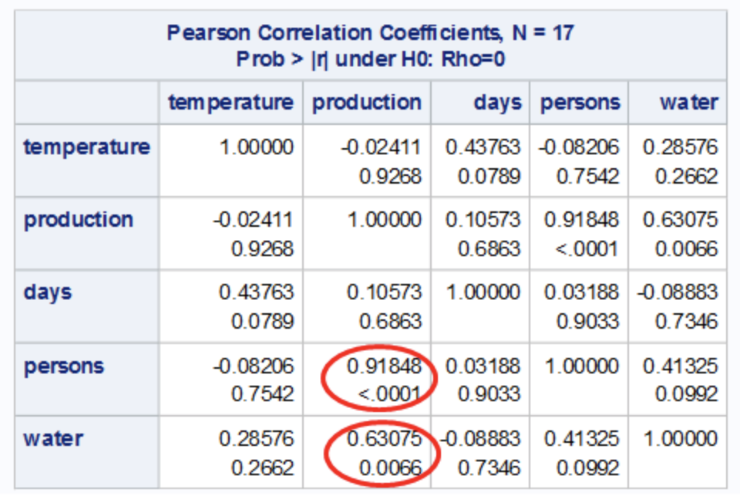
Variables Correlation

Slide 2
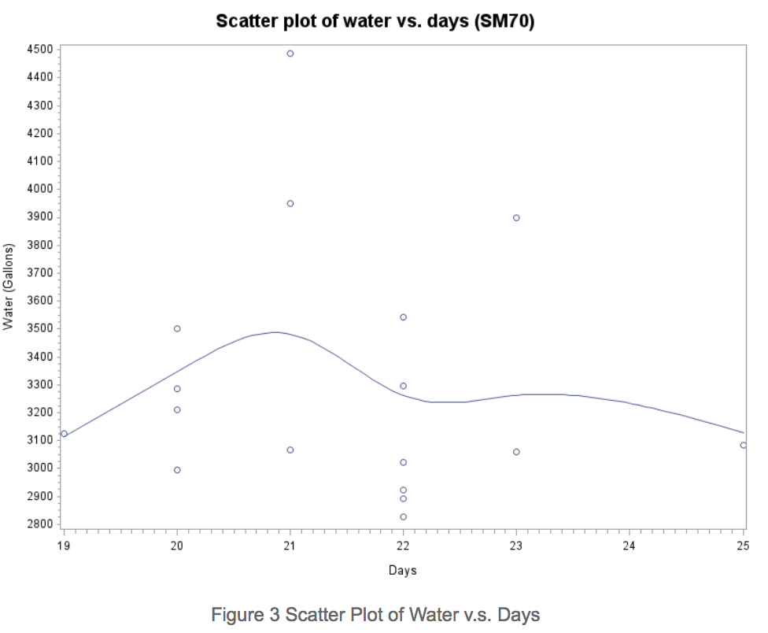
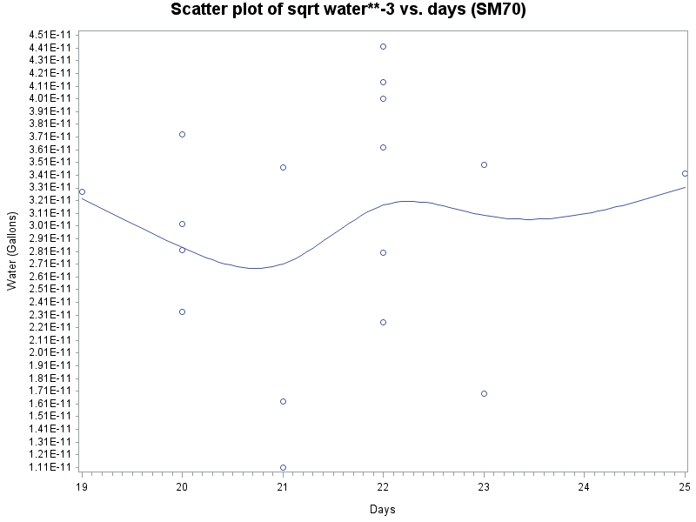
Variables Transformation - Days
Just keep it!
Box-Cox Transformation -3

Slide 3
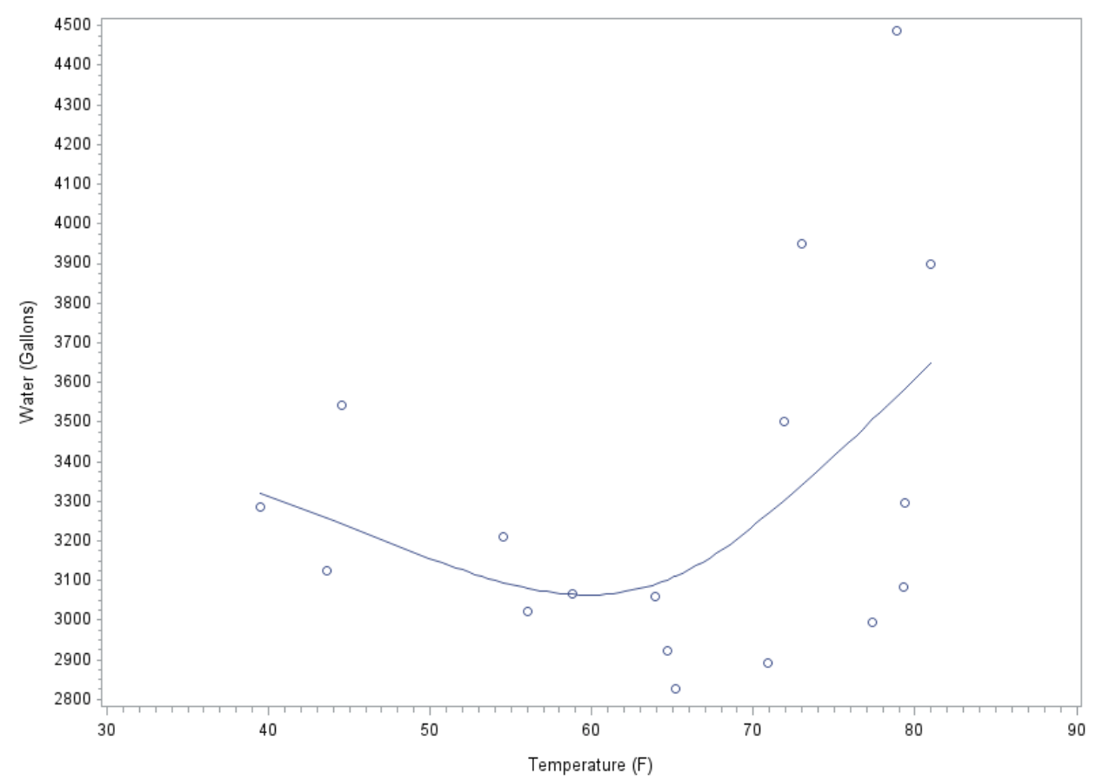
Variables Transformation - Temperature
Solutions:
Quadratic
Centering
Problems:
Variance
Cluster

Slide 4
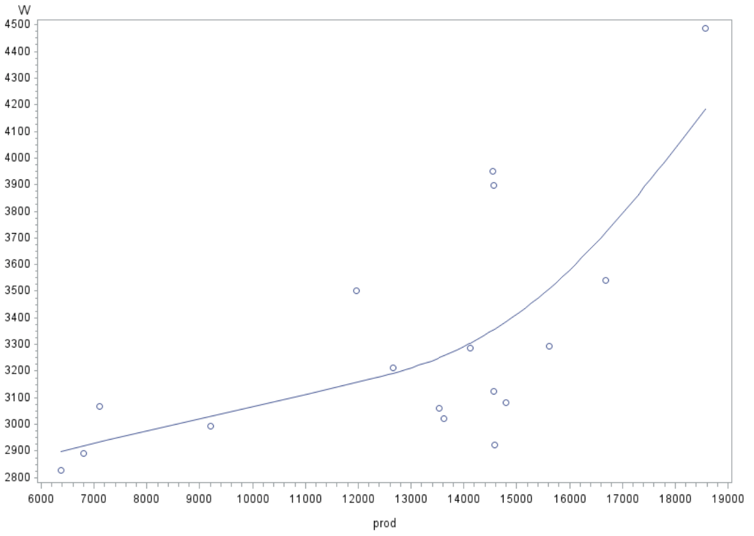
Variables Transformation - Production

Slide 5
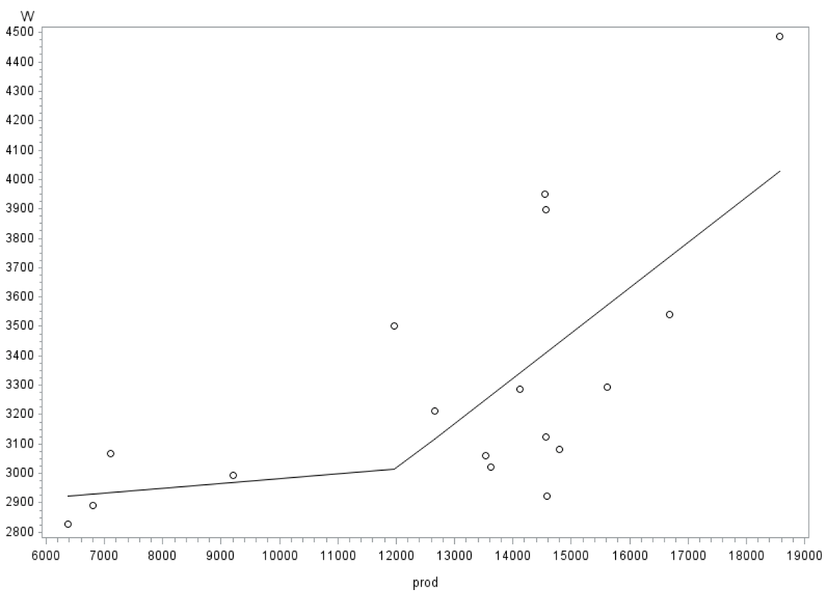
Variables Transformation - Production

Slide 6
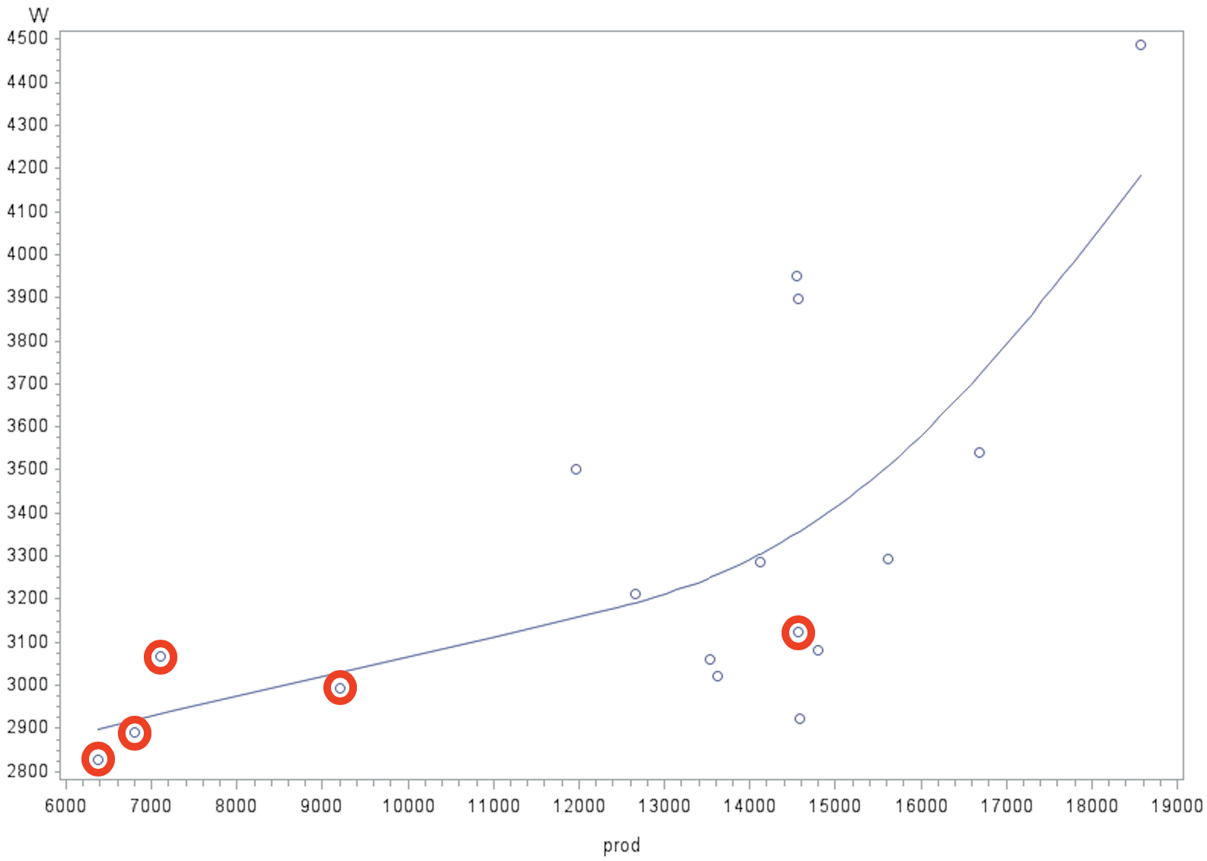
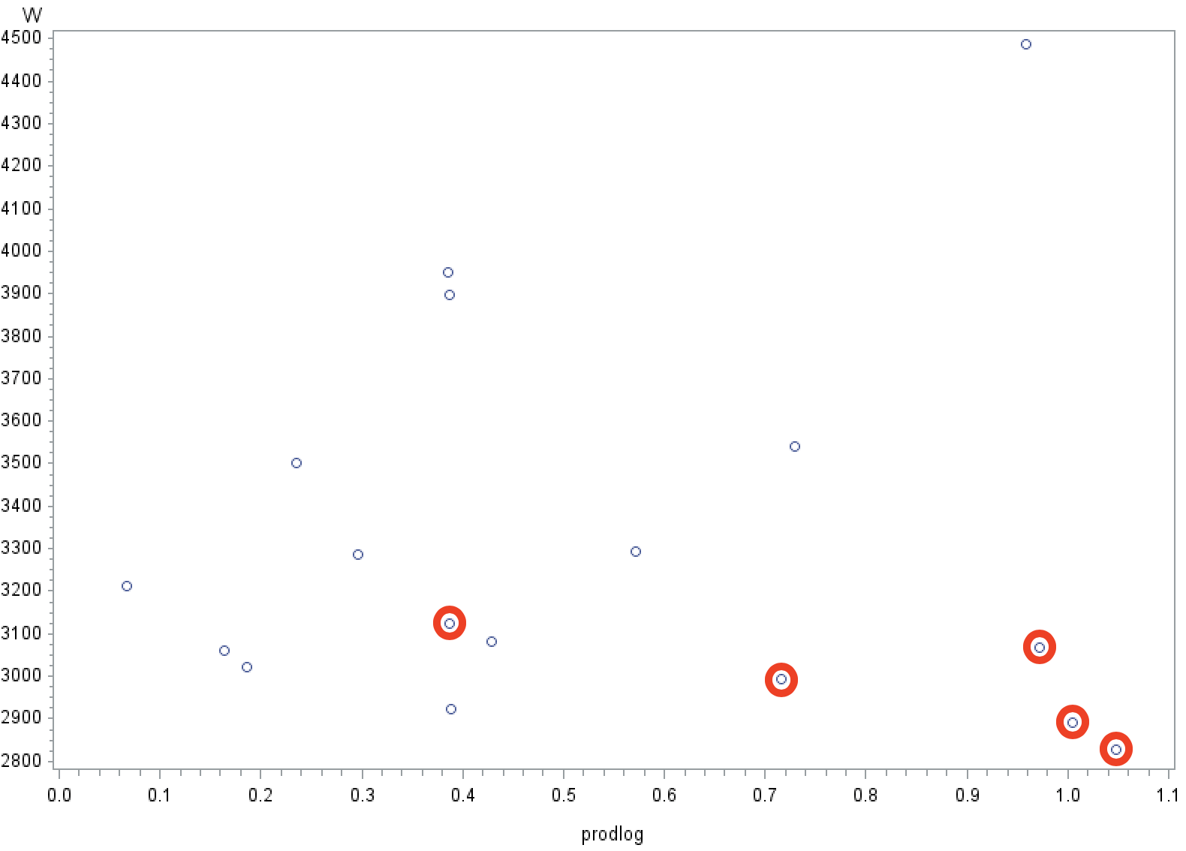
Variables Transformation - Production

Slide 7
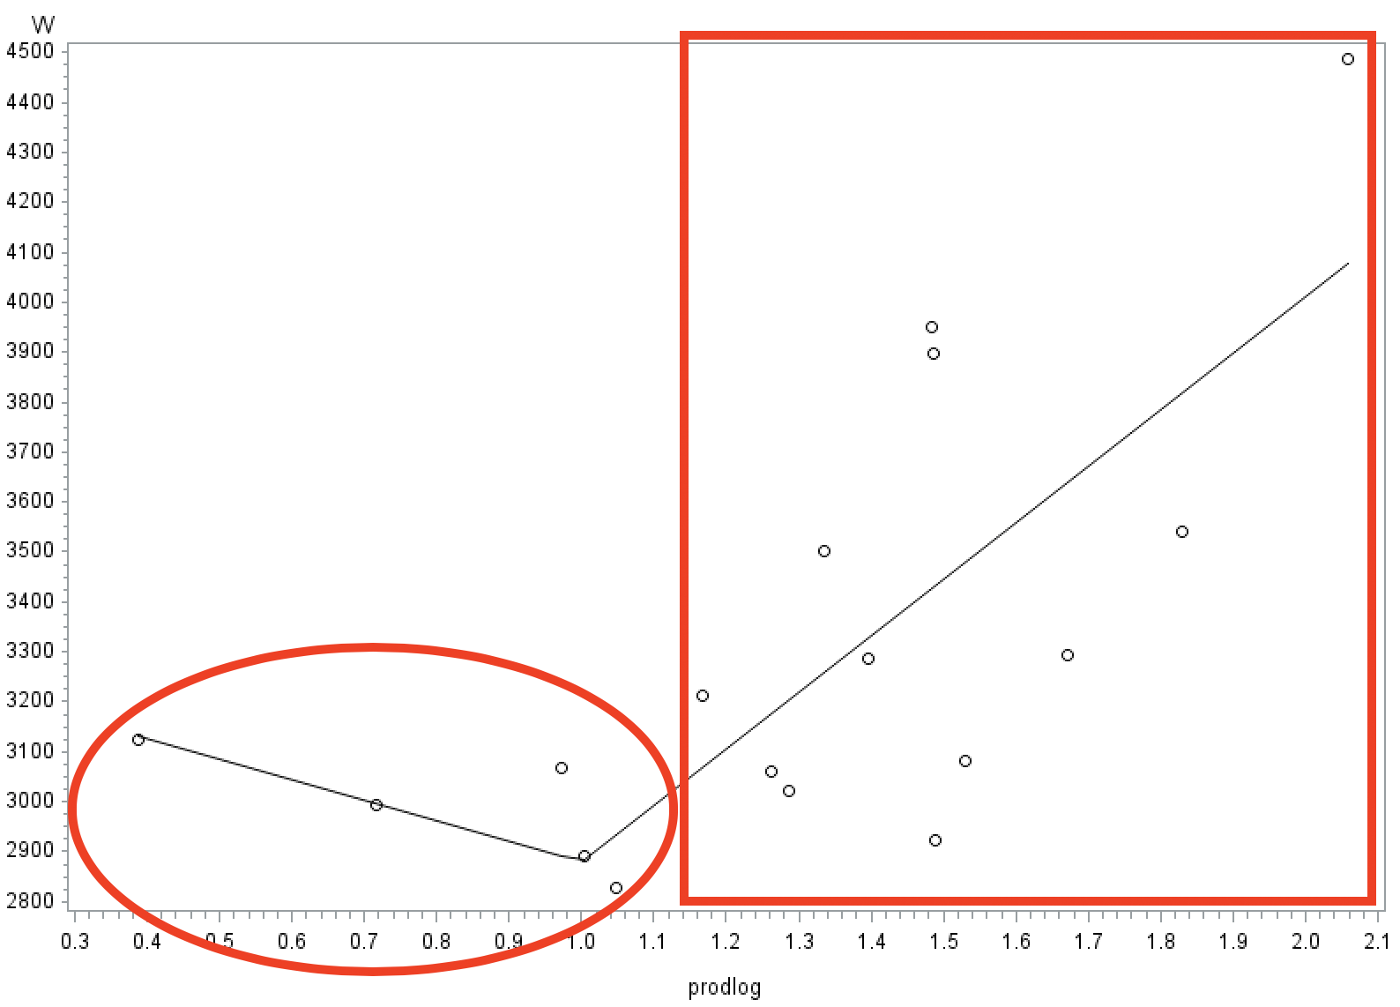
Variables Transformation - Production

Slide 8
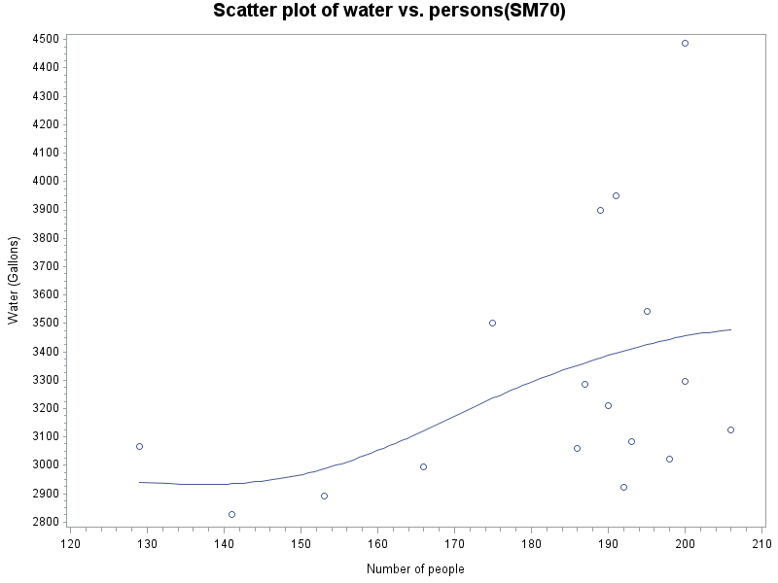
Variables Transformation - Persons
Just keep it!

